Slide 1

The Association Between Demographics and Serial Serum Lactate Measurements
Lactate Lumineers Team 3

Slide 2
Topic and Research Question
Topic Assigned: "Is it the case that a consistent laboratory finding leads to the same treatment or outcome for all patients?”
Final Research Question: Are demographic differences associated with frequency of lactate measurements within 24 hours of intensive care unit (ICU) admission in adult sepsis patients?

Slide 3

Disparities in Healthcare
There is a growing body of literature that explores racial, ethnic, and socioeconomic disparities in healthcare, however research addressing inequities in laboratory measurements is scant
Sepsis affects almost 2 million patients annually and contributes to nearly 300,000 deaths annually
Eliminating health equity disparities in early assessment and treatment of sepsis is the focus of this study
https://www.aafp.org/news/health-of-the-public/health-equity-framework.html
https://www.sepsis.org/news/racial-equity-in-sepsis-care-matters/

Slide 4

Importance of Serum Lactate in Sepsis
Sepsis contributes to nearly 250,000 deaths in the U.S alone
Serum lactate is often used as a surrogate marker for tissue hypoxia
Early measurement can help with early detection of sepsis, facilitate expeditious treatment, and provide prognostic value
Accordingly the use of serum lactate testing in cases of suspected or diagnosed sepsis has increased dramatically over the last two decades
Elevated serum lactate level refractory to resuscitation can help with source identification

Slide 5

References
Jansen TC, van Bommel J, Schoonderbeek FJ, et al. Early lactate-guided therapy in intensive care unit patients: a multicenter, open-label, randomized controlled trial. Am J Respir Crit Care Med. 2010;182(6):752-761. doi:10.1164/rccm.200912-1918OC
Trzeciak S, Dellinger RP, Chansky ME, Arnold RC, Schorr C, Milcarek B, Hollenberg SM, Parrillo JE. Serum lactate as a predictor of mortality in patients with infection. Intensive Care Med. 2007;33 (6):970–977.
Rhee C, Murphy MV, Li L, Platt R, Klompas M; Centers for Disease Control and Prevention Prevention Epicenters Program. Lactate Testing in Suspected Sepsis: Trends and Predictors of Failure to Measure Levels. Crit Care Med. 2015 Aug;43(8):1669-76. doi: 10.1097/CCM.0000000000001087. PMID: 25962082; PMCID: PMC4506241

Slide 6

Significance of Serial Lactate Measurements
Repeat measurements of serum lactate can be critical to monitor response to resuscitation and facilitate early interventions
Surviving Sepsis guidelines recommend 2-4 hour monitoring following the initial lactate level is measured (2)
Numerous studies indicate that trending serum lactate levels to normalization is associated with improved outcomes
Levy MM, Evans LE, Rhodes A. The surviving sepsis campaign bundle: 2018 Update. Crit Care Med. 2018;46:997–1000.

Slide 7

Dataset Information
MIMIC IV
Important Identifiers
[1] "F" "M"
[1] "Black" "Other" "White" "Asian" "Hispanic"
[1] "ENGLISH" "?"
[1] "Medicare" "Other" "Medicaid"

Slide 8
Sepsis Defined
Sepsis is defined as a suspicion of infection associated with organ failure as quantified by an increase in SOFA ≥ 2. This definition is admittedly a proxy for the actual onset of sepsis, but in the absence of more precise markers, it serves as an approximation of onset time and could be used for the development of decision support tools.
Alistair E W Johnson and others, The MIMIC Code Repository: enabling reproducibility in critical care research, Journal of the American Medical Informatics Association, Volume 25, Issue 1, January 2018, Pages 32–39, https://doi.org/10.1093/jamia/ocx084

Slide 9
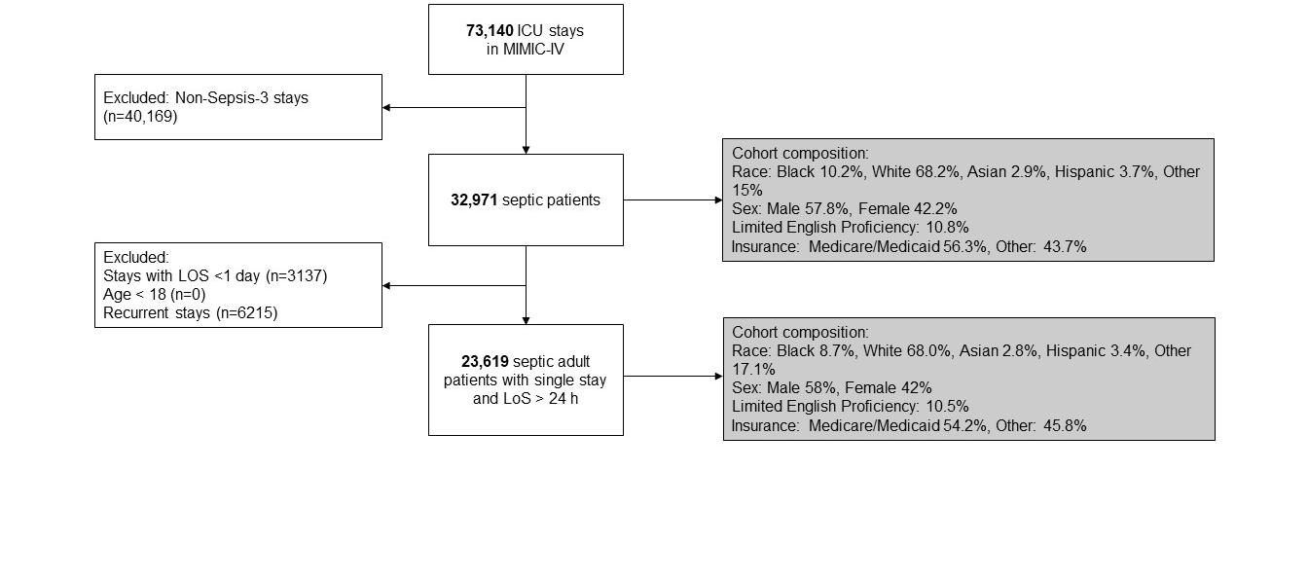
Cohort Selection

Slide 10
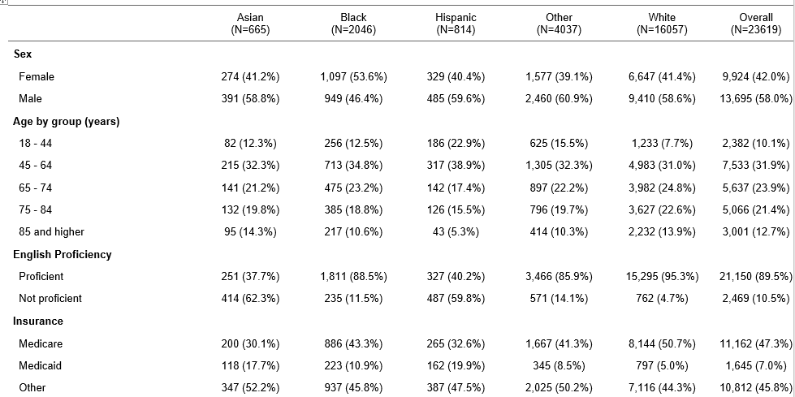
Table 1

Slide 11
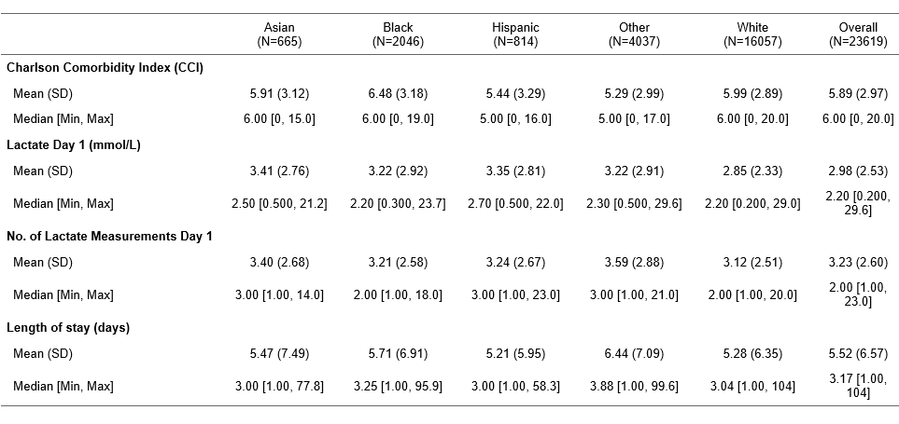
Table 1 cont.

Slide 12
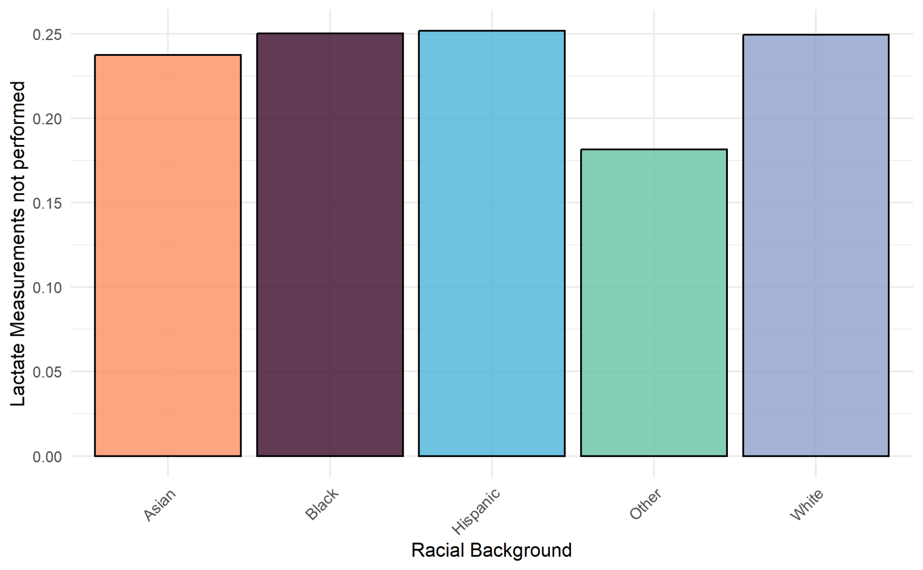

Slide 13
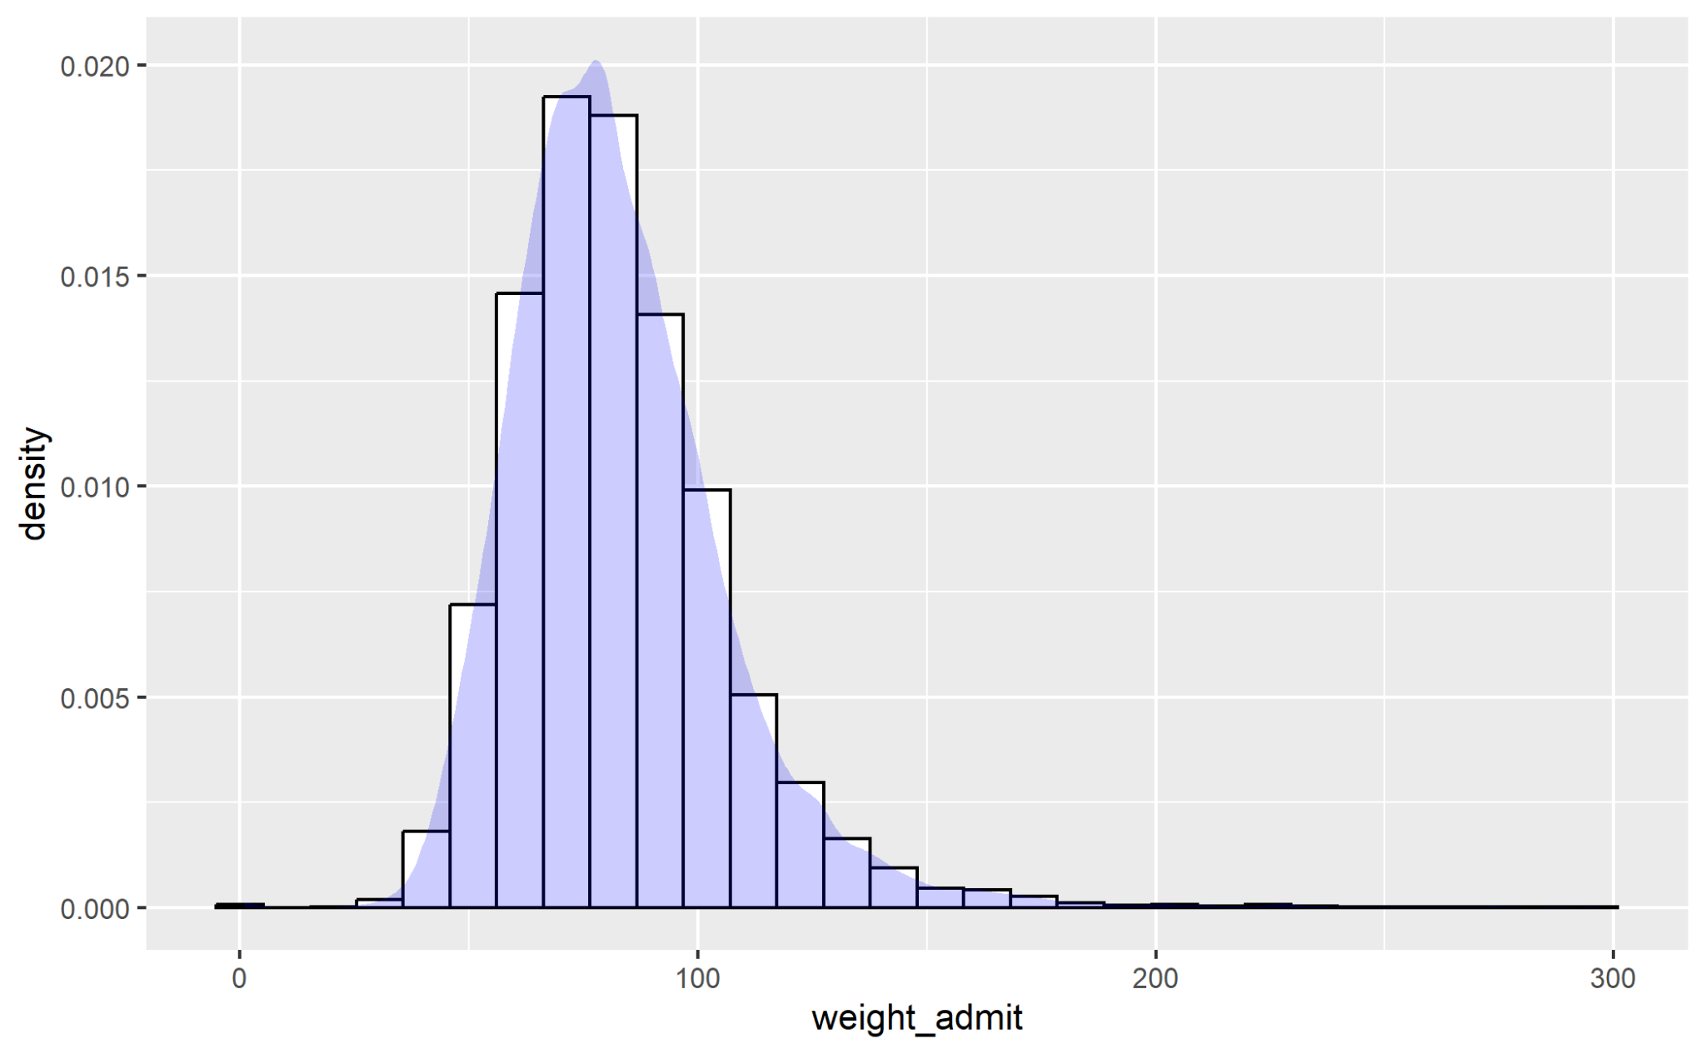
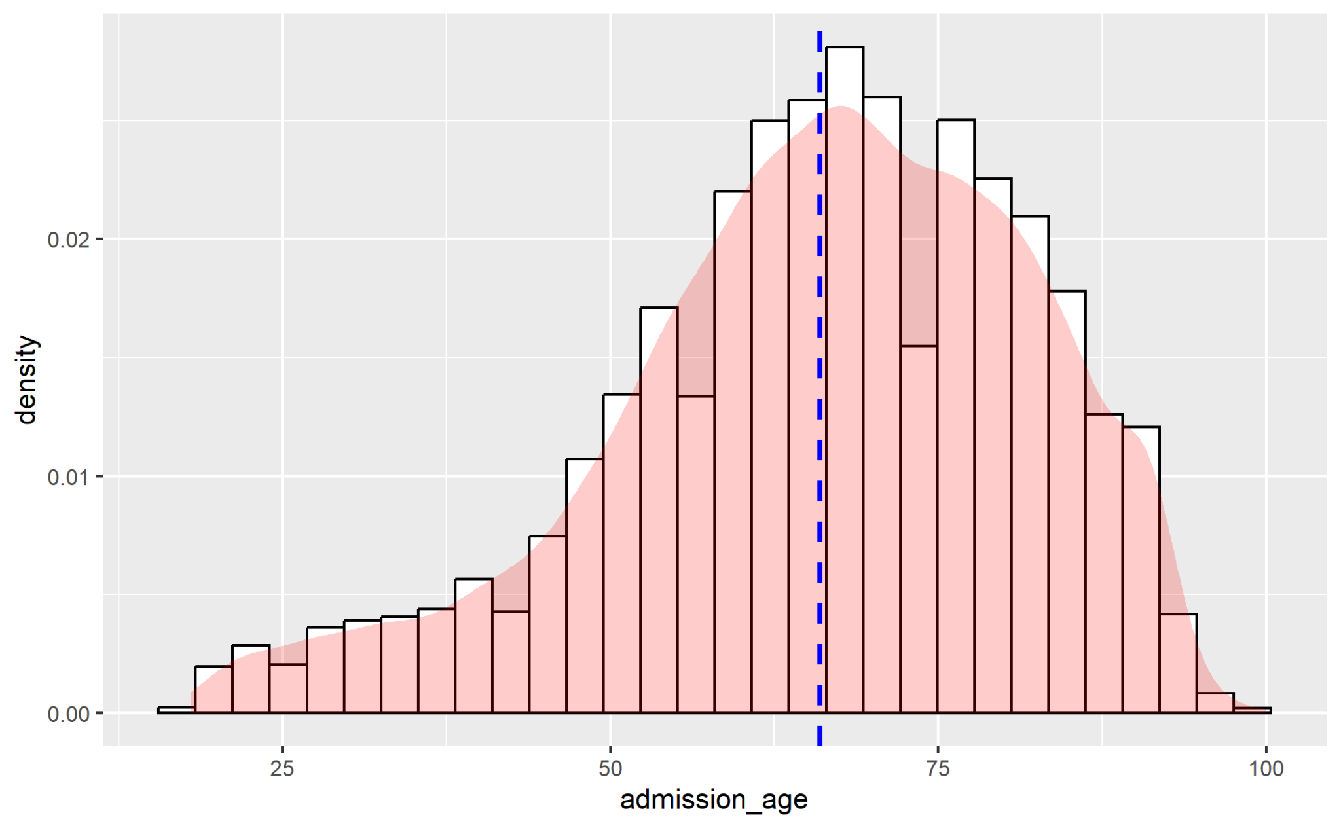
Data Exploration Weight & Age

Slide 14
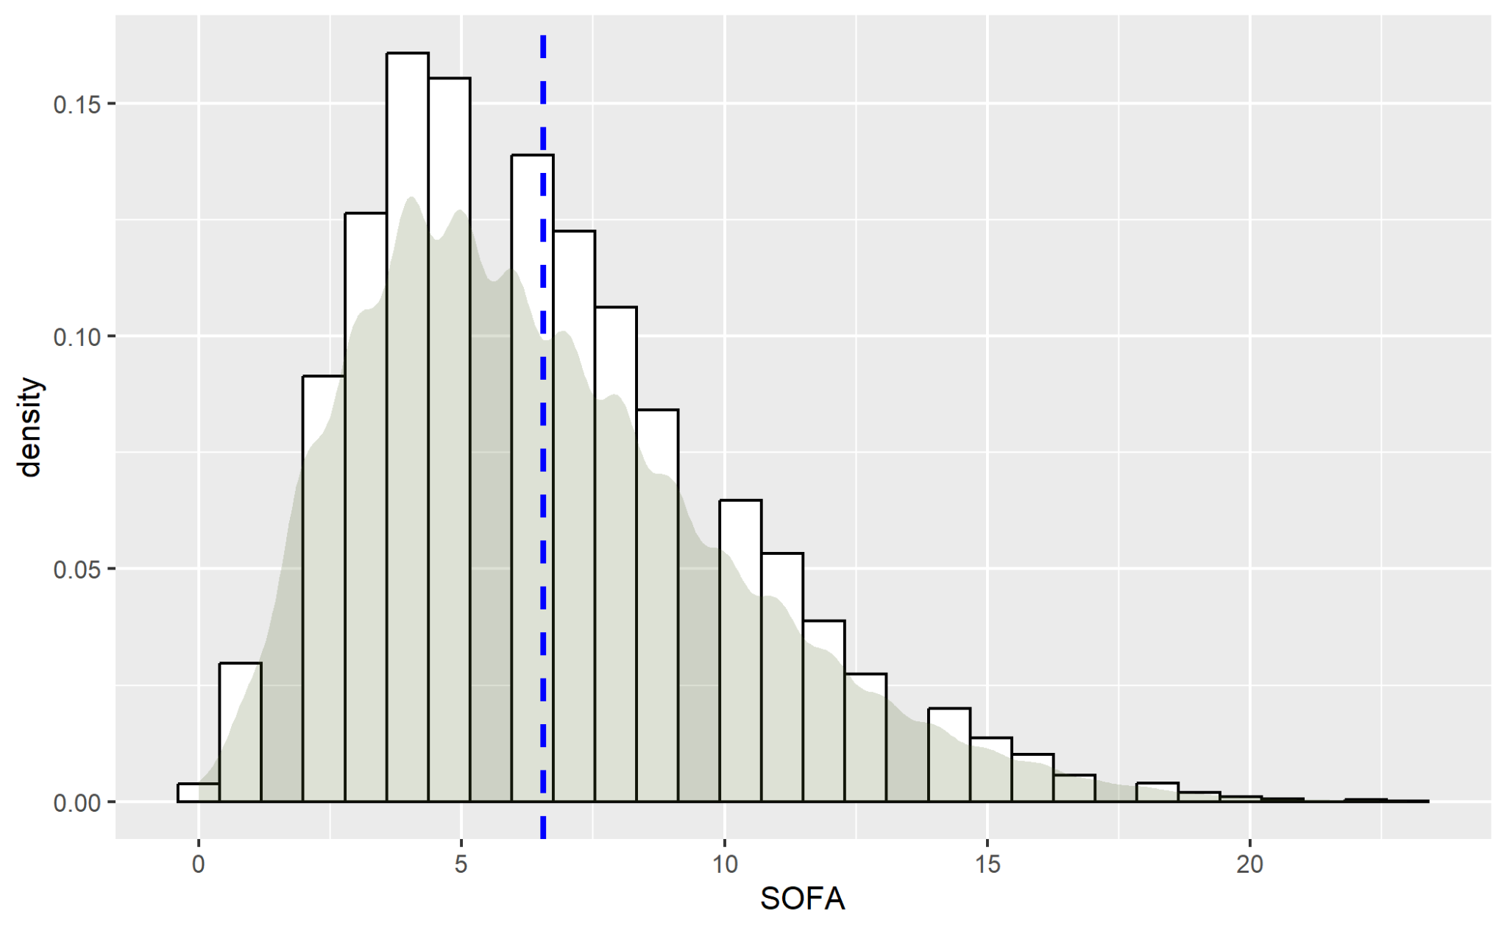
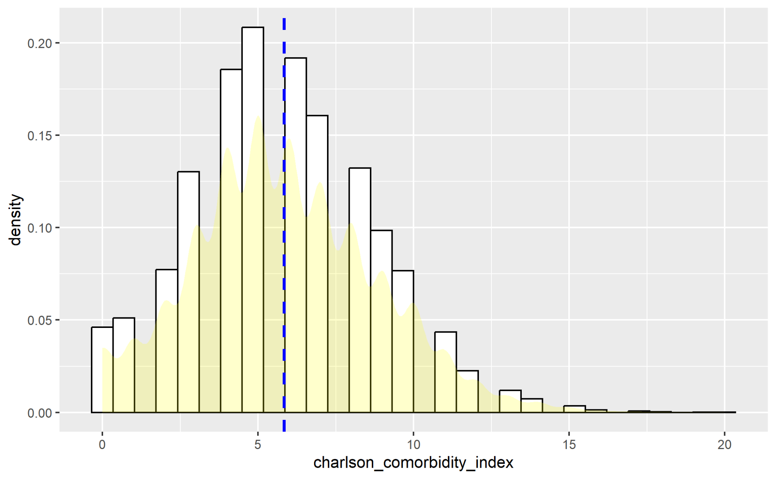
Exploratory Analysis cont.

Slide 15
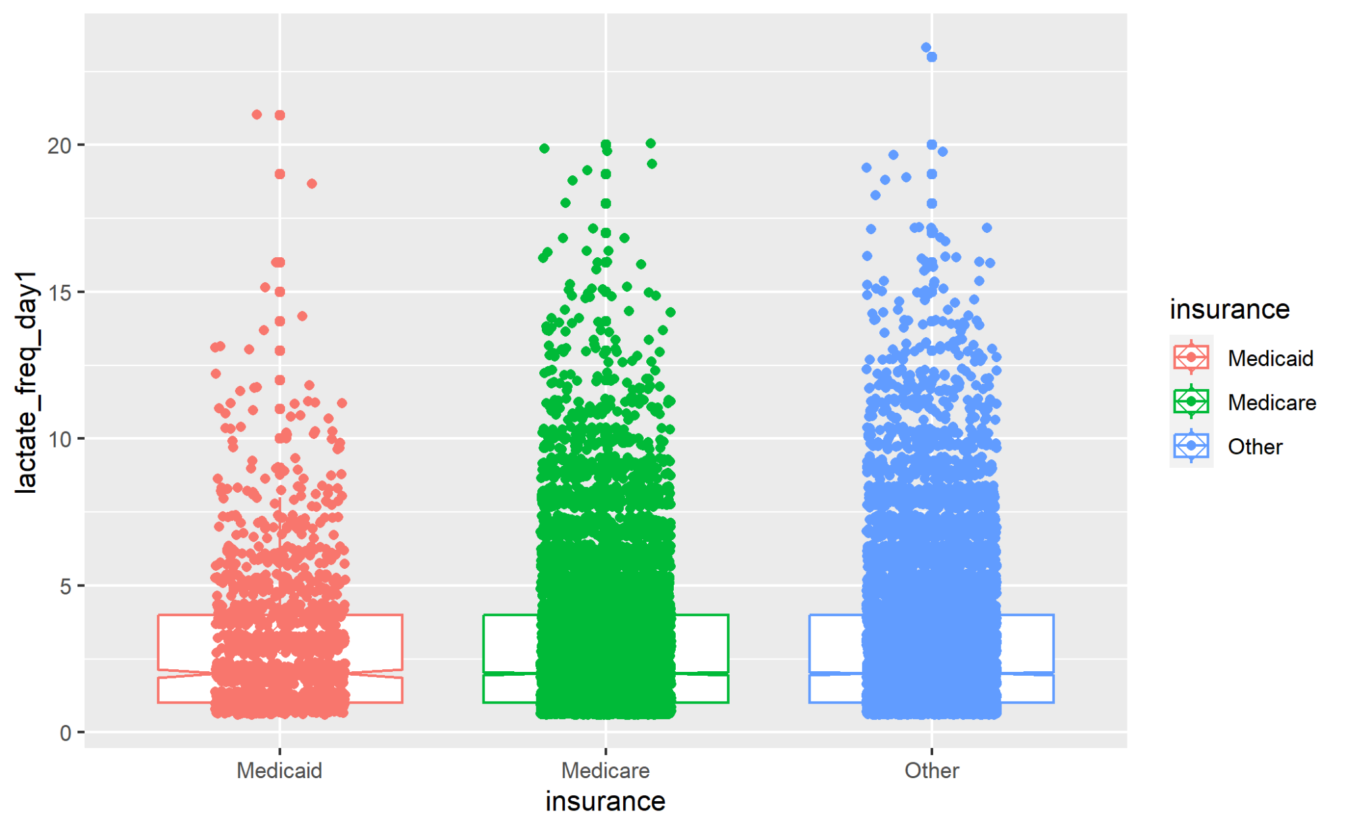
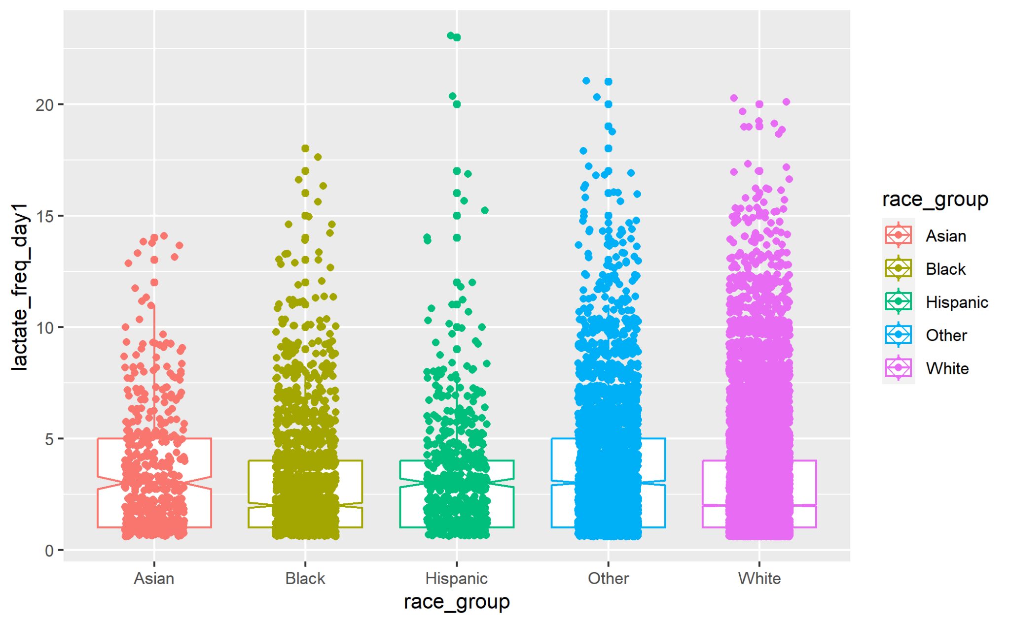
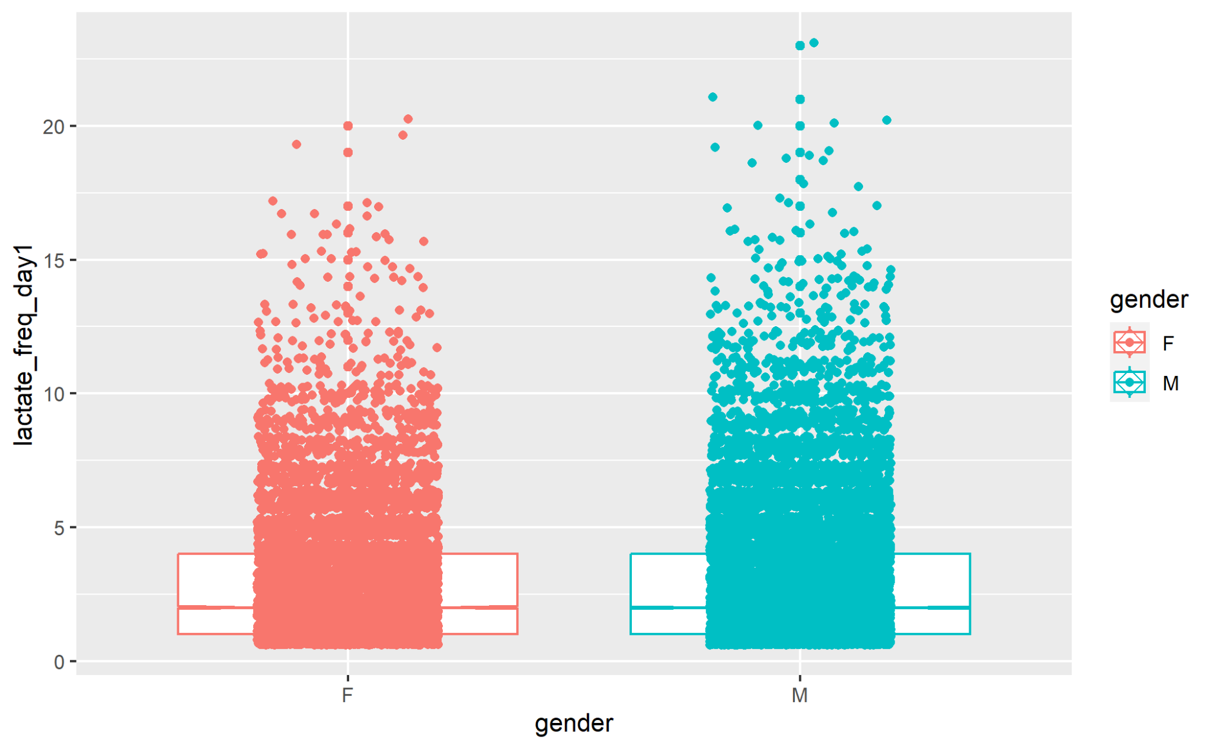
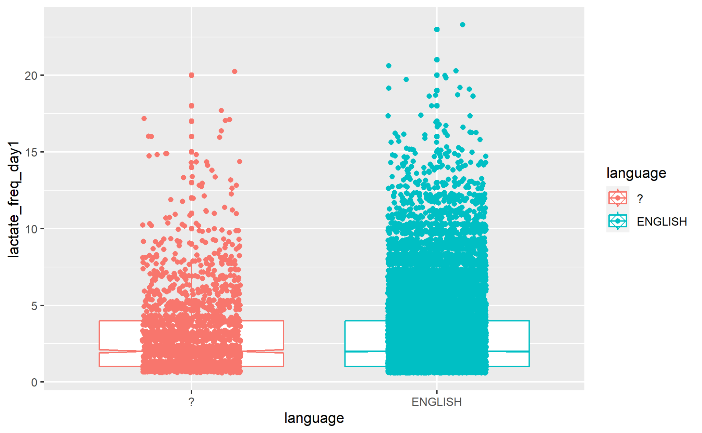

Slide 16
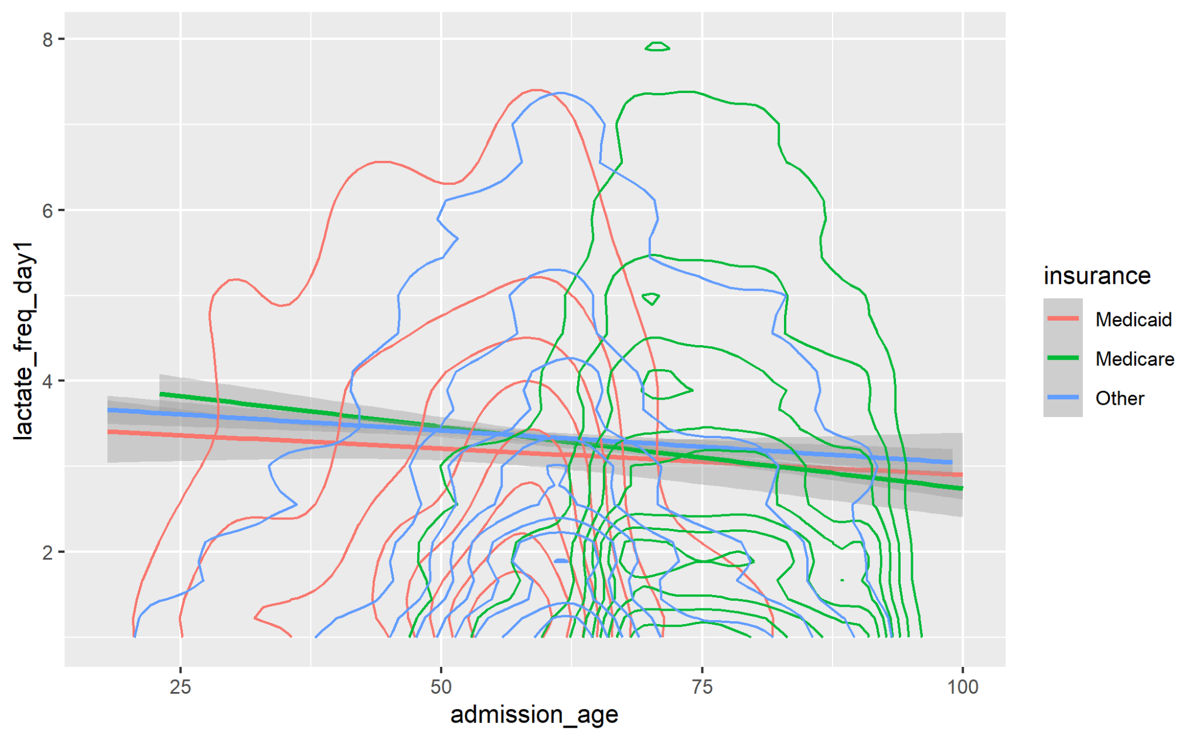
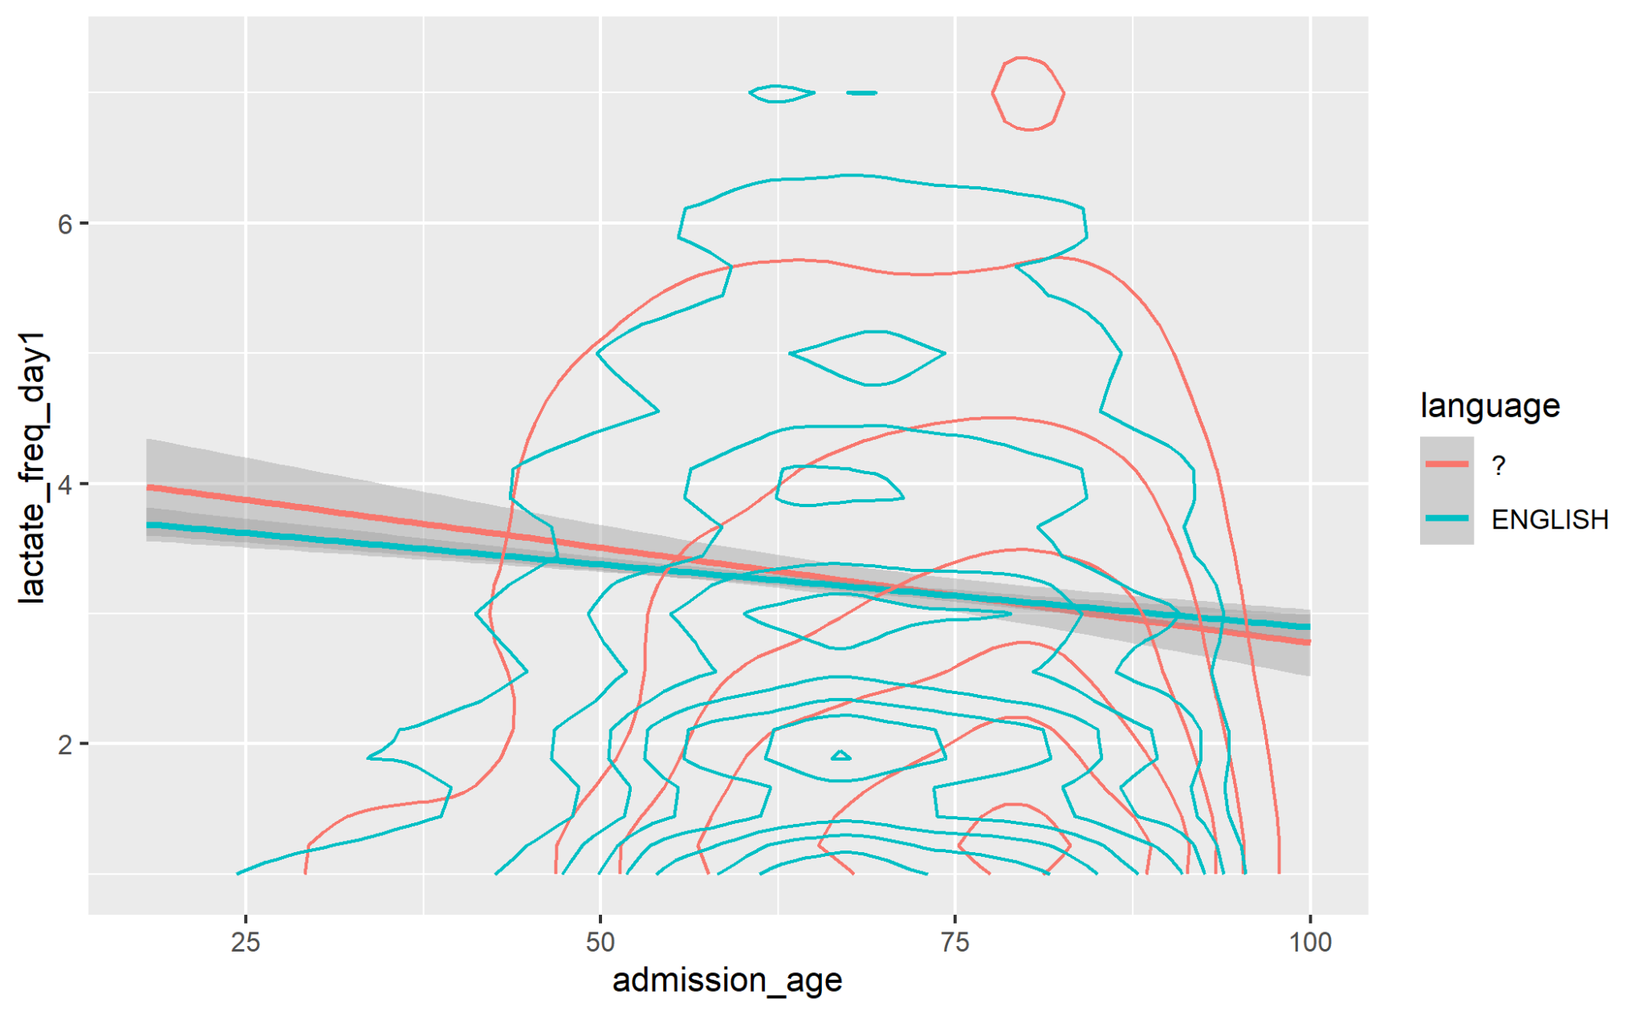

Slide 17
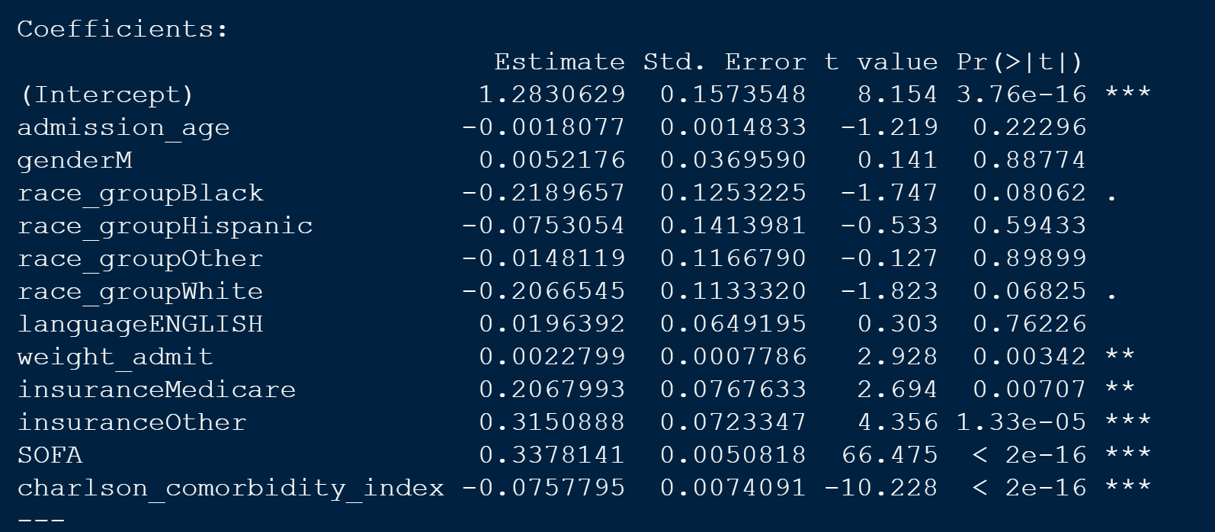

Slide 18
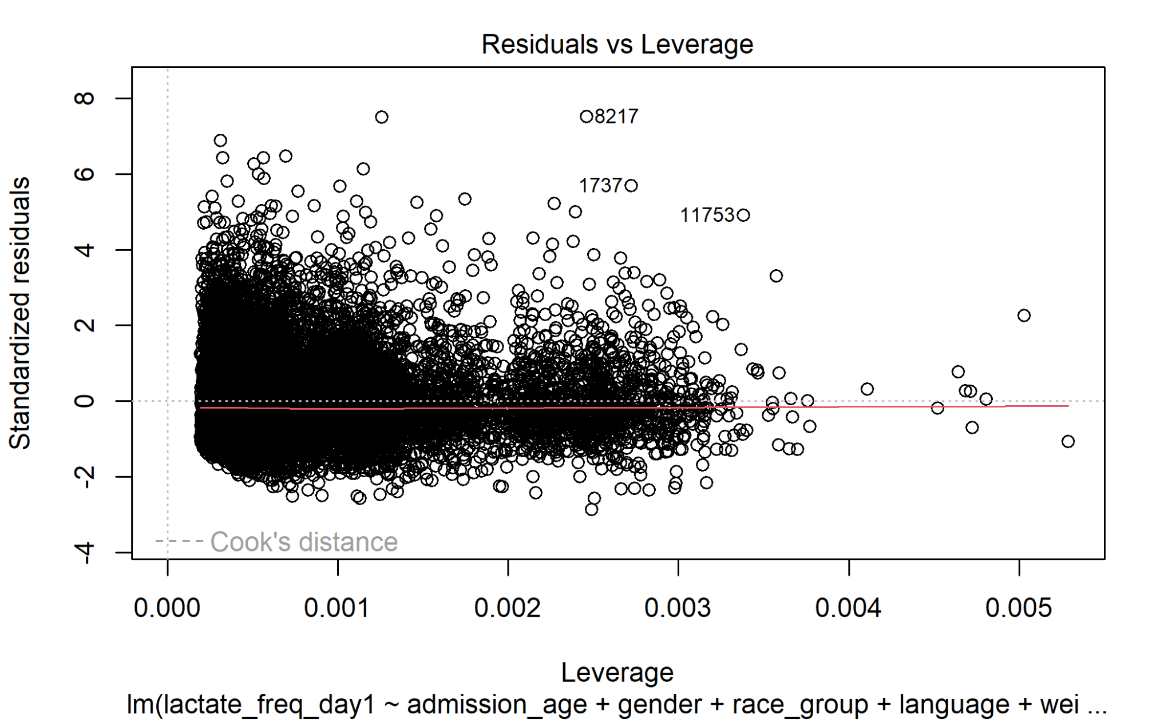
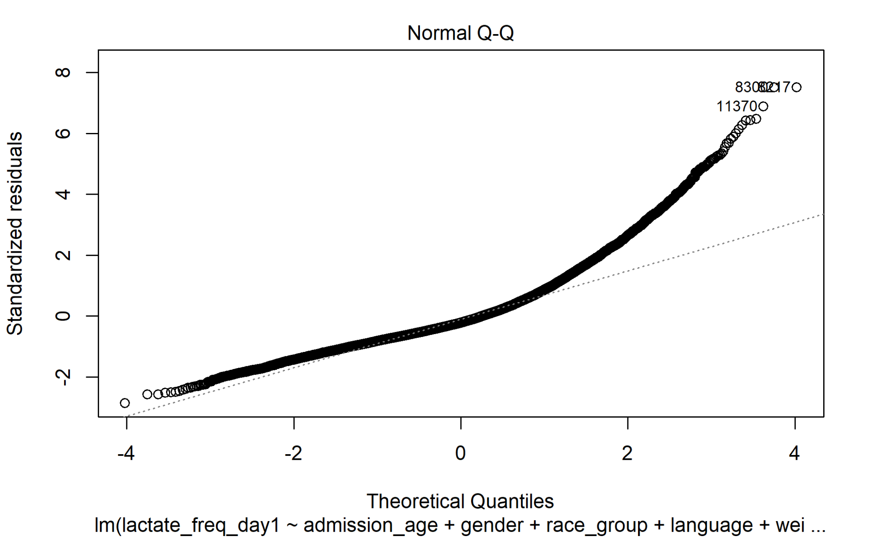
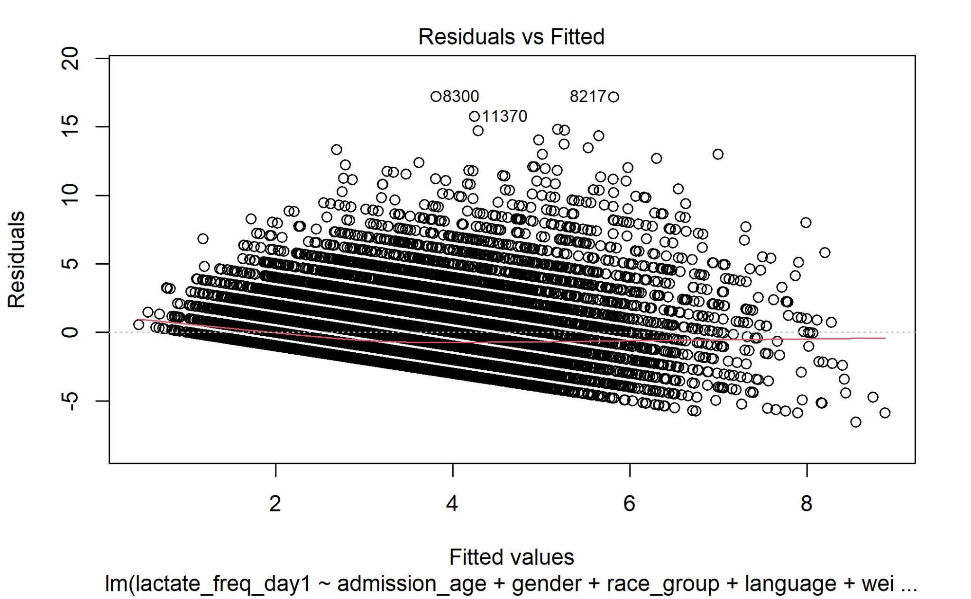
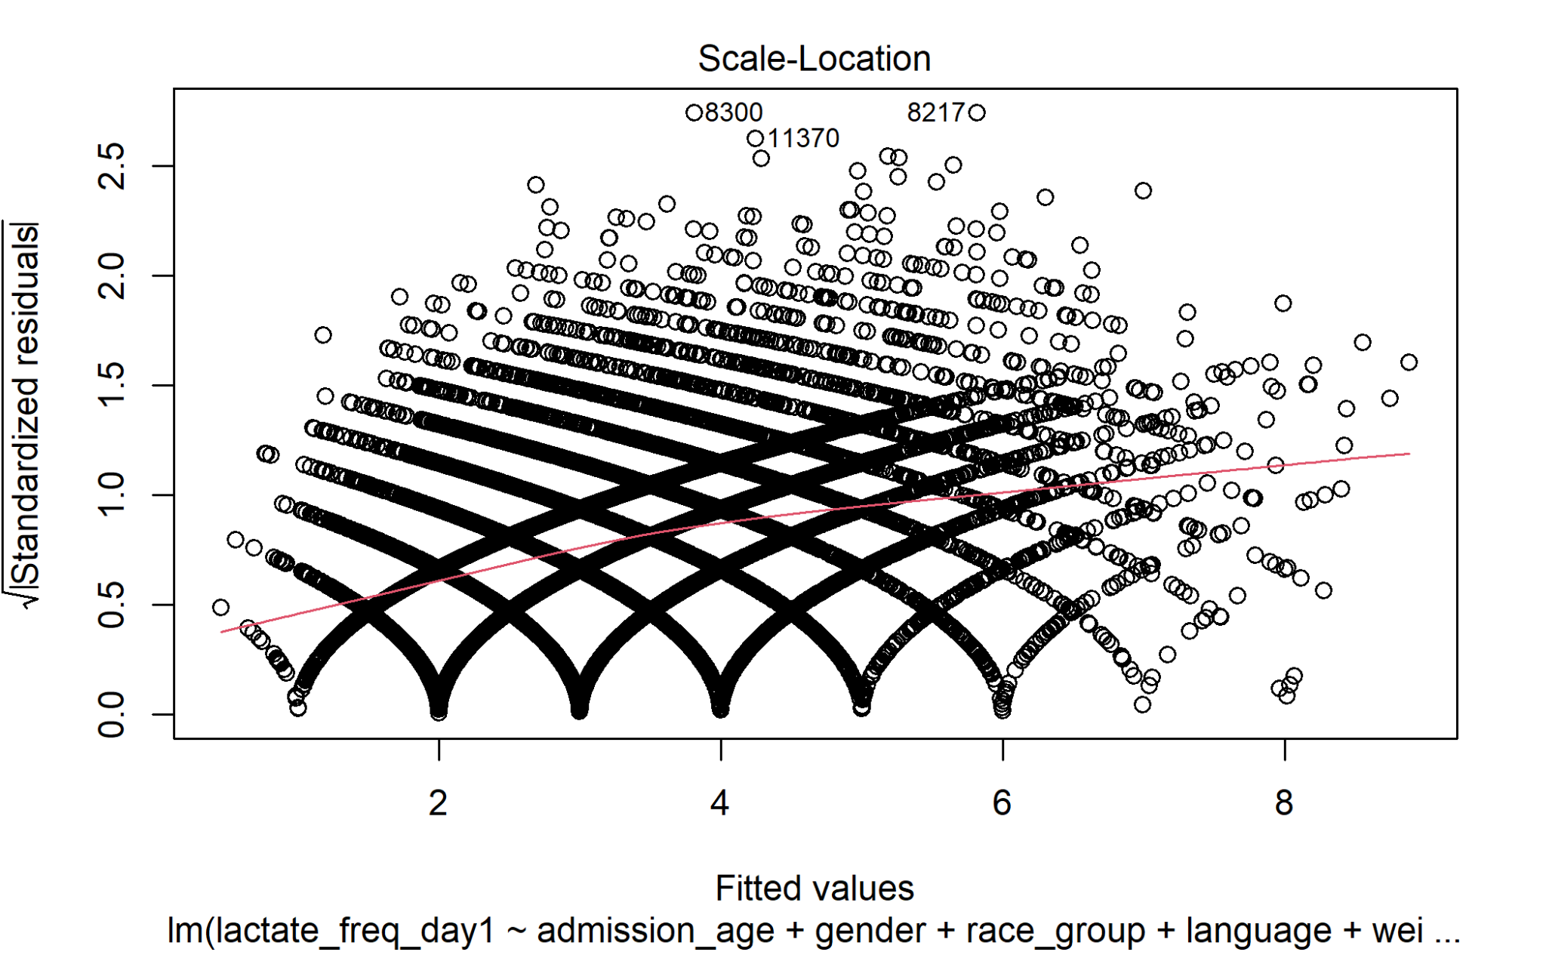

Slide 19

Future Directions
Findings arise from a single hospital center, however hospitals around the globe may vary according to resource and presence or absence of sepsis protocols
The estimate of patients with sepsis may be incomplete due to common misclassification and underdiagnosis
Limitations of the model include:
Elevated Lactate levels can be related to other etiologies such as liver dysfunction, renal injury, and hyperadrenergic states in which case clinicians may not have felt that lactates would provide additional useful clinical information
Notes:
https://pubmed.ncbi.nlm.nih.gov/34544182/
https://pubmed.ncbi.nlm.nih.gov/27520452/

Slide 20
Future Directions
There is a growing body of literature that explores racial, ethnic, and socioeconomic disparities in healthcare, however research addressing inequities in frequency of laboratory measurements is scant
As more predictive biomarkers become available assessing equitable access to these tests should be evaluated
Apply methodology to multicenter datasets
Acquire more granular demographic/SDoH/Improved race-ethnicity
Consider the other side - is anyone being over-treated? Does this affect LOS or mortality?
Observer-expected? (People that die day 1 may have affected datasets
Notes:
https://pubmed.ncbi.nlm.nih.gov/34544182/
https://pubmed.ncbi.nlm.nih.gov/27520452/

